Slide 1
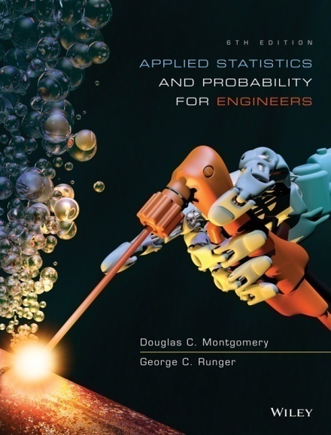
Applied Statistics and Probability for Engineers
Sixth Edition
Douglas C. Montgomery George C. Runger
Chapter 12
Multiple Linear Regression

Slide 2
12
Multiple Linear Regression
CHAPTER OUTLINE
12-1 Multiple Linear Regression Model
12-1.1 Introduction
12-1.2 Least squares estimation of the
parameters
12-1.3 Matrix approach to multiple linear
regression
12-1.4 Properties of the least squares
estimators
12-2 Hypothesis Tests in Multiple Linear
Regression
12-2.1 Test for significance of regression
12-2.2 Tests on individual regression
coefficients & subsets of coefficients
12-3 Confidence Intervals in Multiple
Linear Regression
12-3.1 Use of t-tests
12-3.2 Confidence interval on the mean
response
12-4 Prediction of New Observations
12-5 Model Adequacy Checking
12-5.1 Residual analysis
12-5.2 Influential observations
12-6 Aspects of Multiple Regression
Modeling
12-6.1 Polynomial regression models
12-6.2 Categorical regressors & indicator
variables
12-6.3 Selection of variables & model
building
12-6.4 Multicollinearity

Slide 3
Learning Objectives for Chapter 12
After careful study of this chapter, you should be able to do the following:
Use multiple regression techniques to build empirical models to engineering and scientific data.
Understand how the method of least squares extends to fitting multiple regression models.
Assess regression model adequacy.
Test hypotheses and construct confidence intervals on the regression coefficients.
Use the regression model to estimate the mean response, and to make predictions and to construct confidence intervals and prediction intervals.
Build regression models with polynomial terms.
Use indicator variables to model categorical regressors.
Use stepwise regression and other model building techniques to select the appropriate set of variables for a regression model.

Slide 4
12-1: Multiple Linear Regression Model
12-1.1 Introduction
Many applications of regression analysis involve situations in which there are more than one regressor variable.
A regression model that contains more than one regressor variable is called a multiple regression model.

Slide 5
12-1: Multiple Linear Regression Model
12-1.1 Introduction
For example, suppose that the effective life of a cutting tool depends on the cutting speed and the tool angle. A possible multiple regression model could be
Y = β₀ + β₁x₁ + β₂ x ₂ + ε
(12-1)
where
Y – tool life
x₁ – cutting speed
x₂ – tool angle

Slide 6
12-1: Multiple Linear Regression Model
12-1.2 Least Squares Estimation of the Parameters
The method of least squares may be used to estimate the regression coefficients in the multiple regression model,
Y = β₀ + β₁x₁ + β₂ x ₂ +…+ β_{K} x _{K} + ε. Suppose that n > k observations are available, and let x_{ij} denote the ith observation or level of variable x_{j}. The observations are
(x_{i1}, x_{i2, …,} x_{ik,} y_{i}), i = 1, 2, …, n and n > k
It is customary to present the data for multiple regression in a table such as Table 12-1.
Table 12-1 Data for Multiple Linear Regression
y | x₁ | x₂ | … | x_{k}
y₁ | x₁₁ | x₁₂ | … | x_{1k}
y₂ | x₂₁ | x₂₂ | … | x_{2k}
y_{n} | x_{n1} | x_{n2} | … | x_{nk}

Slide 7
12-1: Multiple Linear Regression Model
12-1.2 Least Squares Estimation of the Parameters
The least squares function is given by
(12-2)
The least squares estimates must satisfy
(12-3)
and
(12-4)

Slide 8
12-1: Multiple Linear Regression Model
12-1.2 Least Squares Estimation of the Parameters
The least squares normal equations are
(12-5)
The solution to the normal equations are the least squares estimators of the regression coefficients.

Slide 9
12-1: Multiple Linear Regression Model
EXAMPLE 12-1 Wire Bond Strength In Chapter 1, we used data on pull strength of a wire bond in a semiconductor manufacturing process, wire length, and die height to illustrate building an empirical model. We will use the same data, repeated for convenience in Table 12-2, and show the details of estimating the model parameters. A three-dimensional scatter plot of the data is presented in Fig. 1-15. Figure12-4 shows a matrix of two-dimensional scatter plots of the data. These displays can be helpful in visualizing the relationships among variables in a multivariable data set. For example, the plot indicates that there is a strong linear relationship between strength and wire length.

Slide 10
12-1: Multiple Linear Regression Model
Example 12-1
Table 12-2 Wire Bond Data for Example 12-1
Observation Number | Pull Strength y | Wire Length x₁ | Die Height x₂ | Observation Number | Pull Strength y | Wire Length x₁ | Die Height x₂
1 | 9.95 | 2 | 50 | 14 | 11.66 | 2 | 360
2 | 24.45 | 8 | 110 | 15 | 21.65 | 4 | 205
3 | 31.75 | 11 | 120 | 16 | 17.89 | 4 | 400
4 | 35.00 | 10 | 550 | 17 | 69.00 | 20 | 600
5 | 25.02 | 8 | 295 | 18 | 10.30 | 1 | 585
6 | 16.86 | 4 | 200 | 19 | 34.93 | 10 | 540
7 | 14.38 | 2 | 375 | 20 | 46.59 | 15 | 250
8 | 9.60 | 2 | 52 | 21 | 44.88 | 15 | 290
9 | 24.35 | 9 | 100 | 22 | 54.12 | 16 | 510
10 | 27.50 | 8 | 300 | 23 | 56.63 | 17 | 590
11 | 17.08 | 4 | 412 | 24 | 22.13 | 6 | 100
12 | 37.00 | 11 | 400 | 25 | 21.15 | 5 | 400
13 | 41.95 | 12 | 500

Slide 11
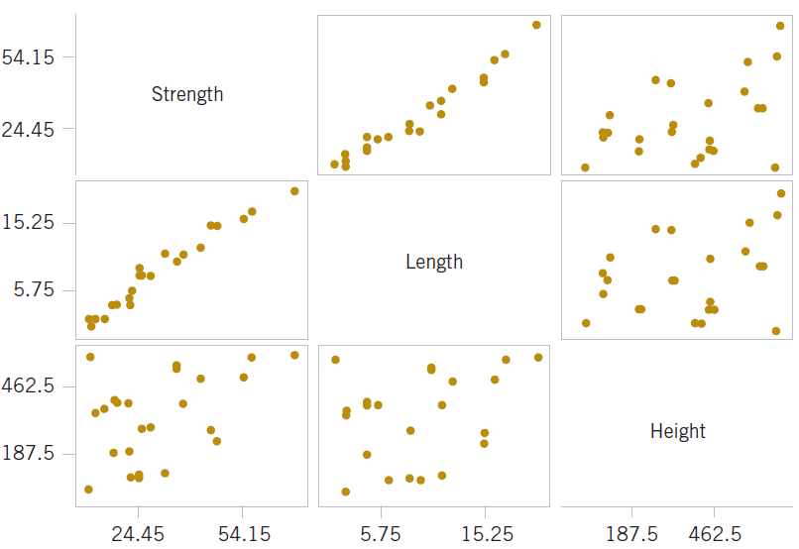
12-1: Multiple Linear Regression Model
Figure 12-4 Matrix of computer-generated scatter plots for the wire bond pull strength data in Table 12-2.

Slide 12
12-1: Multiple Linear Regression Model
Example 12-1
Specifically, we will fit the multiple linear regression model
Y= β₀ + β₁x₁ + β₂x ₂ + ε
where Y = pull strength, x₁ = wire length, and x₂ = die height. From the data in Table 12-2 we calculate

Slide 13
12-1: Multiple Linear Regression Model
Example 12-1
For the model Y = β₀ + β₁x₁ + β₂ x ₂ + ε, the normal equations (12-5) are
Inserting the computed summations into the normal equations, we obtain

Slide 14
12-1: Multiple Linear Regression Model
Example 12-1
The solution to this set of equations is
Therefore, the fitted regression equation is
Practical Interpretation: This equation can be used to predict pull strength for pairs of values of the regressor variables wire length (x₁) and die height (x₂). This is essentially the same regression model given in Section 1-3. Figure 1-16 shows a three-dimensional plot of the plane of predicted values generated from this equation.

Slide 15
12-1: Multiple Linear Regression Model
12-1.3 Matrix Approach to Multiple Linear Regression
Suppose the model relating the regressors to the response is
In matrix notation this model can be written as
y = Xβ + ε
(12-6)

Slide 16
12-1: Multiple Linear Regression Model
12-1.3 Matrix Approach to Multiple Linear Regression
where

Slide 17
12-1: Multiple Linear Regression Model
12-1.3 Matrix Approach to Multiple Linear Regression
We wish to find the vector of least squares estimators that minimizes:
The resulting least squares estimate is
(12-7)

Slide 18
12-1: Multiple Linear Regression Model
12-1.3 Matrix Approach to Multiple Linear Regression
The fitted regression model is
(12-8)
In matrix notation, the fitted model is
The difference between the observation y_{i} and the fitted value is a residual, say, . The (n × 1) vector of residuals is denoted by
(12-9)

Slide 19
12-1: Multiple Linear Regression Model
Example 12-2
In Example 12-1, we illustrated fitting the multiple regression model
y = β₀ + β₁x₁ + β₂x₂ + ε
where y is the observed pull strength for a wire bond, x₁ is the wire length, and x₂ is the die height. The 25 observations are in Table 12-2. We will now use the matrix approach to fit the regression model above to these data. The model matrix X and y vector for this model are

Slide 20
Example 12-2

Slide 21
12-1: Multiple Linear Regression Model
Example 12-2
The X′X matrix is
and the X′y vector is
The least squares estimates are found from Equation 12-7 as

Slide 22
12-1: Multiple Linear Regression Model
Example 12-2
or
Therefore, the fitted regression model with the regression coefficients rounded to five decimal places is
This is identical to the results obtained in Example 12-1.

Slide 23
12-1: Multiple Linear Regression Model
Example 12-2
This regression model can be used to predict values of pull strength for various values of wire length (x₁) and die height (x₂). We can also obtain the fitted values by substituting each observation (x_{i1,} x_{i2}), i = 1, 2, …, n, into the equation. For example, the first observation has x₁₁ = 2 and
x₁₂ = 50, and the fitted value is
The corresponding observed value is y₁ = 9.95. The residual corresponding to the first observation is
Table 12-3 displays all 25 fitted values and the corresponding residuals. The fitted values and residuals are calculated to the same accuracy as the original data.

Slide 24
12-1: Multiple Linear Regression Model
Example 12-2
Table 12-3 Observations, Fitted Values, and Residuals for Example 12-2
Observation Number | y_{i} |  |  | Observation Number | y_{i}
1 | 9.95 | 8.38 | 1.57 | 14 | 11.66 | 12.26 | –0.60
2 | 24.45 | 25.60 | –1.15 | 15 | 21.65 | 15.81 | 5.84
3 | 31.75 | 33.95 | –2.20 | 16 | 17.89 | 18.25 | –0.36
4 | 35.00 | 36.60 | –1.60 | 17 | 69.00 | 64.67 | 4.33
5 | 25.02 | 27.91 | –2.89 | 18 | 10.30 | 12.34 | –2.04
6 | 16.86 | 15.75 | 1.11 | 19 | 34.93 | 36.47 | –1.54
7 | 14.38 | 12.45 | 1.93 | 20 | 46.59 | 46.56 | 0.03
8 | 9.60 | 8.40 | 1.20 | 21 | 44.88 | 47.06 | –2.18
9 | 24.35 | 28.21 | –3.86 | 22 | 54.12 | 52.56 | 1.56
10 | 27.50 | 27.98 | –0.48 | 23 | 56.63 | 56.31 | 0.32
11 | 17.08 | 18.40 | –1.32 | 24 | 22.13 | 19.98 | 2.15
12 | 37.00 | 37.46 | –0.46 | 25 | 21.15 | 21.00 | 0.15
13 | 41.95 | 41.46 | 0.49

Slide 25
12-1: Multiple Linear Regression Model
Table 12-4 Minitab Multiple Regression Output for the Wire Bond Pull Strength Data
Regression Analysis: Strength versus :Length, Height
The regression equation is
Strength = 2.26 + 2.74 Length + 0.0125 Height
Predictor Coef SE Coef T P VIF
Constant 2.264 1.060 2.14 0.044
Length 2.74427 0.09352 29.34 0.000 1.2
Height 0.012528 0.002798 4.48 0.000 1.2
S = 2.288 R-Sq = 98.1% R-Sq (adj) = 97.9%
PRESS = 156.163 R-Sq (pred) = 97.44%
Analysis of Variance
Source DF SS MS F P
Regression 2 5990.8 2995.4 572.17 0.000
Residual Error 22 115.2 5.2
Total 24 6105.9
Source DF Seq SS
Length 1 5885.9
Height 1 104.9
Predicted Values for New Observations
New Obs Fit SE Fit 95.0% CI 95.0% PI
1 27.663 0.482 (26.663, 28.663) (22.814, 32.512)
Values of Predictors for New Observations
News Obs Length Height
1 8.00 275

Slide 26
12-1: Multiple Linear Regression Model
Estimating σ²
An unbiased estimator of σ² is
(12­10)

Slide 27
12-1: Multiple Linear Regression Model
12-1.4 Properties of the Least Squares Estimators
Unbiased estimators:
Covariance Matrix:

Slide 28
12-1: Multiple Linear Regression Model
12-1.4 Properties of the Least Squares Estimators
Individual variances and covariances:
In general,

Slide 29
12-2: Hypothesis Tests in Multiple Linear Regression
12-2.1 Test for Significance of Regression
The appropriate hypotheses are
H_{1:} β_{j} ≠ 0 for at least one j (12­11)
The test statistic is
(12­12)

Slide 30
12-2: Hypothesis Tests in Multiple Linear Regression
12-2.1 Test for Significance of Regression
Table 12-9 Analysis of Variance for Testing Significance of Regression in Multiple Regression
Source of Variation | Sum of Squares | Degrees of Freedom | Mean Square | F₀
Regression | SS_{R} | k | MS_{R} | MS_{R}/MS_{E}
Error or residual | SS_{E} | n–p | MS_{E}
Total | SS_{T} | n – 1

Slide 31
12-2: Hypothesis Tests in Multiple Linear Regression
EXAMPLE 12-3 Wire Bond Strength ANOVA We will test for significance of regression (with α = 0.05) using the wire bond pull strength data from Example 12-1. The total sum of squares is

Slide 32
12-2: Hypothesis Tests in Multiple Linear Regression
Example 12-3
The regression or model sum of squares is computed as follows:
and by subtraction

Slide 33
12-2: Hypothesis Tests in Multiple Linear Regression
Example 12-3
The analysis of variance is shown in Table 12-10. To test H₀: β₁ = β₂ = 0, we calculate the statistic
Since f₀ > f_{0.05,2,22}= 3.44 (or since the P­value is considerably smaller than α = 0.05), we reject the null hypothesis and conclude that pull strength is linearly related to either wire length or die height, or both.
Practical Interpretation: Rejection of H₀ does not necessarily imply that the relationship found is an appropriate model for predicting pull strength as a function of wire length and die height. Further tests of model adequacy are required before we can be comfortable using this model in practice.

Slide 34
12-2: Hypothesis Tests in Multiple Linear Regression
Example 12-3
Table 12­10 Test for Significance of' Regression for Example 12-3
Source of Variation | Sum of Squares | Degrees of Freedom | Mean Square | f₀ | P­value
Regression | 5990.7712 | 2 | 2995.3856 | 572.17 | 1.08E-19
Error or residual | 115.1735 | 22 | 5.2352
Total | 6105.9447 | 24

Slide 35
12-2: Hypothesis Tests in Multiple Linear Regression
R² and Adjusted R²
The coefficient of multiple determination
(12­13)
For the wire bond pull strength data, we find that R² = SS_{R}/SS_{T} = 5990.7712/6105.9447 = 0.9811.
Thus, the model accounts for about 98% of the variability in the pull strength response.

Slide 36
12-2: Hypothesis Tests in Multiple Linear Regression
R² and Adjusted R²
The adjusted R² is
(12­14)
The adjusted R² statistic penalizes the analyst for adding terms to the model.
It can help guard against overfitting (including regressors that are not really useful)

Slide 37
12-2: Hypothesis Tests in Multiple Linear Regression
12-2.2 Tests on Individual Regression Coefficients and Subsets of Coefficients
The hypotheses for testing the significance of any individual regression coefficient:
H₀: β_{j} = β_{j0}
H₁: β_{j} ≠ β_{j0} (12-15)

Slide 38
12-2: Hypothesis Tests in Multiple Linear Regression
12-2.2 Tests on Individual Regression Coefficients and Subsets of Coefficients
The test statistic is
(12-16)
Reject H₀ if |t₀| > t_{α/2,n-p}.
This is called a partial or marginal test

Slide 39
12-2: Hypothesis Tests in Multiple Linear Regression
EXAMPLE 12-4 Wire Bond Strength Coefficient Test Consider the wire bond pull strength data, and suppose that we want to test the hypothesis that the regression coefficient for x₂ (die height) is zero. The hypotheses are
H₀: β₂ = 0
H₁: β₂ ≠ 0
The main diagonal element of the (X′X)⁻¹ matrix corresponding to is C₂₂ = 0.0000015, so the t-statistic in Equation 12-16 is

Slide 40
12-2: Hypothesis Tests in Multiple Linear Regression
Example 12-4
Note that we have used the estimate of σ² reported to four decimal places in Table 12-10. Since t_{0.025,22} = 2.074, we reject H₀: β₂ = 0 and conclude that the variable x₂ (die height) contributes significantly to the model. We could also have used a P-value to draw conclusions. The
P-value for t₀ = 4.477 is P = 0.0002, so with α = 0.05 we would reject the null hypothesis.
Practical Interpretation: Note that this test measures the marginal or partial contribution of x₂ given that x₁ is in the model. That is, the t-test measures the contribution of adding the variable x₂ = die height to a model that already contains x₁ = wire length. Table 12-4 shows the value of the t-test computed by Minitab. The Minitab t-test statistic is reported to two decimal places. Note that the computer produces a t-test for each regression coefficient in the model. These
t-tests indicate that both regressors contribute to the model.

Slide 41
12-2: Hypothesis Tests in Multiple Linear Regression
The general regression significance test or the extra sum of squares method:
y = Xβ + ε
We wish to test the hypotheses:
H₀: β₁ = 0
H₁: β₁ ≠ 0 (12-17)

Slide 42
12-2: Hypothesis Tests in Multiple Linear Regression
A general form of the model can be written:
y = Xβ +ε = X₁β₁ + X₂β₂ + ε
(12-18)
where X₁ represents the columns of X associated with β₁ and X₂ represents the columns of X associated with β₂

Slide 43
12-2: Hypothesis Tests in Multiple Linear Regression
For the full model:
If H₀ is true, the reduced model is
y = X₂β₂ + ε
(12-19)
(12-20)

Slide 44
12-2: Hypothesis Tests in Multiple Linear Regression
The test statistic is:
(12-21)
Reject H₀ if f₀ > f_{α,r,n-p}
The test in Equation (12-21) is often referred to as a partial F-test

Slide 45
12-2: Hypothesis Tests in Multiple Linear Regression
Example 12-6 Wire Bond Strength General Regression Test
Consider the wire bond pull-strength data in Example 12-1. We will investigate the contribution of two new variables, x₃ and x₄, to the model using the partial F-test approach. The new variables are explained at the end of this example. That is, we wish to test
H₀: β₃ = β₄ = 0 H₁: β₃ ≠ 0 or β₄ ≠ 0
To test this hypothesis, we need the extra sum of squares due to β₃ and β₄ or
SS_{R}(β₄, β₃| β₂, β_{1,} β₀) = SS_{R} (β₄, β₃, β₂, β₁, β₀) − SS_{R}(β₂, β₁, β₀)
= SS_{R}(β₄, β₃, β₂, β₁|β₀) − SS_{R} (β₂, β₁|β₀)

Slide 46
12-2: Hypothesis Tests in Multiple Linear Regression
Example 12-6
In Example 12-3 we calculated
Also, Table 12-4 shows the Minitab output for the model with only x₁ and x₂ as predictors. In the analysis of variance table, we can see that SS_{R} = 5990.8 and this agrees with our calculation. In practice, the computer output would be used to obtain this sum of squares.
If we fit the model Y = β₀ + β₁x₁ + β₂x₂ + β₃x₃ + β₄x₄, we can use the same matrix formula. Alternatively, we can look at SS_{R} from computer output for this model. The analysis of variance table for this model is shown in Table 12-11 and we see that
SS_{R}(β₄, β₃, β₂, β₁|β₀) = 6024.0 (four degrees of freedom)
Therefore,
SS_{R}(β₄, β₃|β₂, β₁, β₀) = 6024.0 − 5990.8 = 33.2 (two degrees of freedom)

Slide 47
12-2: Hypothesis Tests in Multiple Linear Regression
Example 12-6
This is the increase in the regression sum of squares due to adding x₃ and x₄ to a model already containing x₁ and x₂. To test H₀, calculate the test statistic
Note that MS_{E} from the full model using x₁, x₂, x₃ and x₄ is used in the denominator of the test statistic. Because f_{0.05, 2, 20} = 3.49, we reject H₀ and conclude that at least one of the new variables contributes significantly to the model. Further analysis and tests will be needed to refine the model and determine if one or both of x₃ and x₄ are important.
The mystery of the new variables can now be explained. These are quadratic powers of the original predictors wire length and wire height. That is, and . A test for quadratic terms is a common use of partial F-tests. With this information and the original data for x₁ and x₂, you can use computer software to reproduce these calculations. Multiple regression allows models to be extended in such a simple manner that the real meaning of x₃ and x₄ did not even enter into the test procedure. Polynomial models such as this are discussed further in Section 12-6.

Slide 48
12-3: Confidence Intervals in Multiple Linear Regression
12-3.1 Confidence Intervals on Individual Regression Coefficients
Definition
A 100(1 - α)% confidence interval on the regression coefficient β_{j}, j = 0, 1, …, k in the multiple linear regression model is given by
(12-22)

Slide 49
12-3: Confidence Intervals in Multiple Linear Regression
Example 12-7 Wire Bond Strength Confidence Interval
We will construct a 95% confidence interval on the parameter β₁ in the wire bond pull strength problem. The point estimate of β₁ is and the diagonal element of (X′X)⁻¹ corresponding to β₁ is C₁₁ = 0.001671. The estimate of σ² is
, and t_{0.025,22} = 2.074. Therefore, the 95% CI on β₁ is computed from Equation 12-22 as
which reduces to
2.55029 ≤ β₁ ≤ 2.93825
Also, computer software such as Minitab can be used to help calculate this confidence interval. From the regression output in Table 10-4, and the standard error of . This standard error is the multiplier of the t-table constant in the confidence interval. That is, . Consequently, all the numbers are available from the computer output to construct the interval and this is the typical method used in practice.

Slide 50
12-3: Confidence Intervals in Multiple Linear Regression
12-3.2 Confidence Interval on the Mean Response
The mean response at a point x₀ is estimated by
(12-23)
The variance of the estimated mean response is
(12-24)

Slide 51
12-3: Confidence Intervals in Multiple Linear Regression
12-3.2 Confidence Interval on the Mean Response
Definition
For the multiple linear regression model, a 100(1 - α)% confidence interval on the mean response at the point x₀₁, x₀₂, …, x_{0k} is
(12-25)

Slide 52
12-3: Confidence Intervals in Multiple Linear Regression
Example 12-8 Wire Bond Strength Confidence Interval on the Mean Response
The engineer in Example 12-1 would like to construct a 95% CI on the mean pull strength for a wire bond with wire length x₁ = 8 and die height x₂ = 275. Therefore,
The estimated mean response at this point is found from Equation 12-23 as

Slide 53
12-3: Confidence Intervals in Multiple Linear Regression
Example 12-8
The variance of is estimated by
Therefore, a 95% CI on the mean pull strength at this point is found from Equation 12-25 as
which reduces to

Slide 54
12-4: Prediction of New Observations
A point estimate of the future observation Y₀ is
A 100(1-α)% prediction interval for this future observation is
(12-26)

Slide 55
12-4: Prediction of New Observations
Example 12-9 Wire Bond Strength Confidence Interval
Suppose that the engineer in Example 12-1 wishes to construct a 95% prediction interval on the wire bond pull strength when the wire length is
x₁ = 8 and the die height is x₂ = 275. Note that , and the point estimate of the pull strength is . Also, in Example 12-8 we calculated . Therefore, from Equation 12-26 we have
and the 95% prediction interval is
22.81 ≤ Y₀ ≤ 32.51
Notice that the prediction interval is wider than the confidence interval on the mean response at the same point, calculated in Example 12-8. The Minitab output in Table 12-4 also displays this prediction interval.

Slide 56
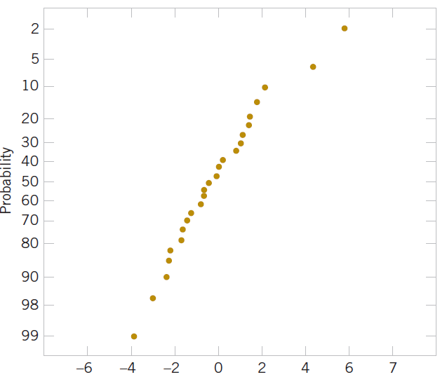
12-5: Model Adequacy Checking
12-5.1 Residual Analysis
Example 12-10
The residuals for the model from Example 12-1 are shown in Table 12-3. A normal probability plot of these residuals is shown in Fig. 12-6. No severe deviations from normality are obviously apparent, although the two largest residuals (e₁₅ = 5.84 and e₁₇ = 4.33) do not fall extremely close to a straight line drawn through the remaining residuals.
Figure 12-6 Normal probability plot of residuals.

Slide 57
12-5: Model Adequacy Checking
12-5.1 Residual Analysis
Example 12-10
The standardized residuals
(12-27)
are often more useful than the ordinary residuals when assessing residual magnitude. For the wire bond strength example, the standardized residuals corresponding to e₁₅ and e₁₇ are
and , and they do not seem unusually large. Inspection of the data does not reveal any error in collecting observations 15 and 17, nor does it produce any other reason to discard or modify these two points.

Slide 58
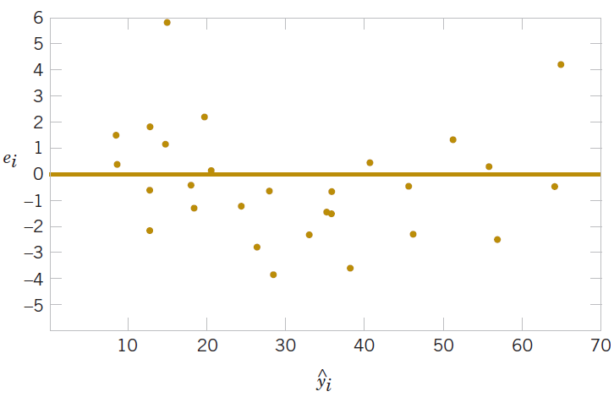
12-5: Model Adequacy Checking
12-5.1 Residual Analysis
Example 12-10
The residuals are plotted against in Fig. 12-7, and against x₁ and x₂ in Figs. 12-8 and 12-9, respectively.* The two largest residuals, e₁₅ and e₁₇, are apparent. Figure 12-8 gives some indication that the model underpredicts the pull strength for assemblies with short wire length (x₁ ≤ 6) and long wire length (x₁ ≥ 15) and overpredicts the strength for assemblies with intermediate wire length (7 ≤ x₁ ≤ 14). The same impression is obtained from Fig. 12-7. Either the relationship between strength and wire length is not linear (requiring that a term involving
, say, be added to the model), or other regressor variables not presently in the model affected the response.
Figure 12-7 Plot of residuals against

Slide 59
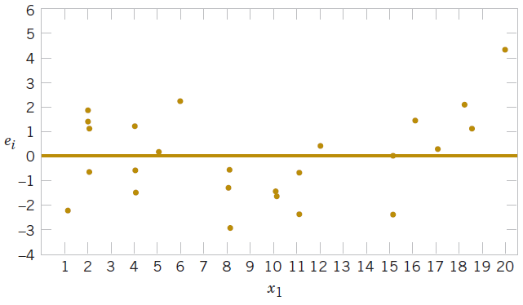
12-5: Model Adequacy Checking
12-5.1 Residual Analysis
Example 12-10
Either the relationship between strength and wire length is not linear (requiring that a term involving , say, be added to the model), or other regressor variables not presently in the model affected the response.
Figure 12-8 Plot of residuals against x₁.

Slide 60
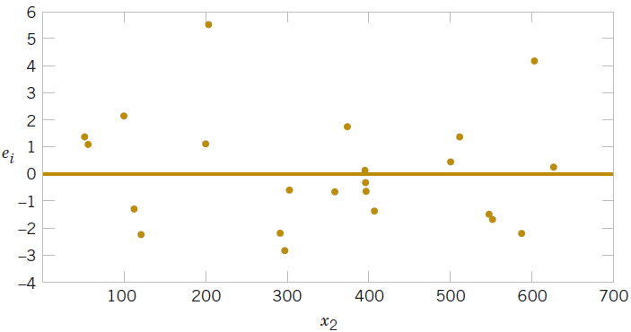
12-5: Model Adequacy Checking
12-5.1 Residual Analysis
Example 12-10
Figure 12-9 Plot of residuals against x₂.

Slide 61
12-5: Model Adequacy Checking
12-5.1 Residual Analysis
(12-28)
where h_{ii} is the ith diagonal element of the matrix
H = X(X′X)⁻¹X′
The H matrix is sometimes called the “hat” matrix, since

Slide 62
12-5: Model Adequacy Checking
12-5.1 Residual Analysis
Since each row of the matrix X corresponds to a vector, say , another way to write the diagonal elements of the hat matrix is
(12-29)
The variance of the ith residual is
V(e_{i}) = σ²(1 - h_{ii}), i = 1, 2, …, n

Slide 63
12-5: Model Adequacy Checking
12-5.1 Residual Analysis
To illustrate, consider the two observations identified in the wire bond strength data (Example 12-10) as having residuals that might be unusually large, observations 15 and 17. The standardized residuals are
Now h_{15,15} = 0.0737 and h_{17,17} = 0.2593, so the studentized residuals are
and
Notice that the studentized residuals are larger than the corresponding standardized residuals. However, the studentized residuals are still not so large as to cause us serious concern about possible outliers.

Slide 64
12-5: Model Adequacy Checking
12-5.2 Influential Observations
Cook’s distance measure
(12-30)

Slide 65
12-5: Model Adequacy Checking
EXAMPLE 12-11 Wire Bond Strength Cook’s Distances Table 12-12 lists the values of the hat matrix diagonals h_{ii} and Cook’s distance measure D_{i} for the wire bond pull strength data in Example 12-1. To illustrate the calculations, consider the first observation:
The Cook distance measure D_{i} does not identify any potentially influential observations in the data, for no value of D_{i} exceeds unity.

Slide 66
12-5: Model Adequacy Checking
Example 12-11
TABLE • 12-8 Influence Diagnostics for the Wire Bond Pull Strength Data
Observations i | h_{ii} | Cook’s Distance Measure D_{i} | Observations i | h_{ii} | Cook’s Distance Measure D_{i}
1 | 0.1573 | 0.035 | 14 | 0.1129 | 0.003
2 | 0.1116 | 0.012 | 15 | 0.0737 | 0.187
3 | 0.1419 | 0.060 | 16 | 0.0879 | 0.001
4 | 0.1019 | 0.021 | 17 | 0.2593 | 0.565
5 | 0.0418 | 0.024 | 18 | 0.2929 | 0.155
6 | 0.0749 | 0.007 | 19 | 0.0962 | 0.018
7 | 0.1181 | 0.036 | 20 | 0.1473 | 0.000
8 | 0.1561 | 0.020 | 21 | 0.1296 | 0.052
9 | 0.1280 | 0.160 | 22 | 0.1358 | 0.028
10 | 0.0413 | 0.001 | 23 | 0.1824 | 0.002
11 | 0.0925 | 0.013 | 24 | 0.1091 | 0.040
12 | 0.0526 | 0.001 | 25 | 0.0729 | 0.000
13 | 0.0820 | 0.001

Slide 67
12-6: Aspects of Multiple Regression Modeling
12-6.1 Polynomial Regression Models
The linear model Y = Xβ + ε is a general model that can be used to fit any relationship that is linear in the unknown parameters β. This includes the important class of polynomial regression models. For example, the second-degree polynomial in one variable
Y = β₀ + β₁x + β₁₁x² + ε (12-31)
and the second-degree polynomial in two variables
(12-32)
are linear regression models.

Slide 68
12-6: Aspects of Multiple Regression Modeling
EXAMPLE 12-12 Airplane Sidewall Panels Sidewall panels for the interior of an airplane are formed in a 1500-ton press. The unit manufacturing cost varies with the production lot size. The data shown below give the average cost per unit (in hundreds of dollars) for this product (y) and the production lot size (x). The scatter diagram, shown in Fig. 12-11, indicates that a second-order polynomial may be appropriate.
y | 1.81 | 1.70 | 1.65 | 1.55 | 1.48 | 1.40
x | 20 | 25 | 30 | 35 | 40 | 50
y | 1.30 | 1.26 | 1.24 | 1.21 | 1.20 | 1.18
x | 60 | 65 | 70 | 75 | 80 | 90

Slide 69
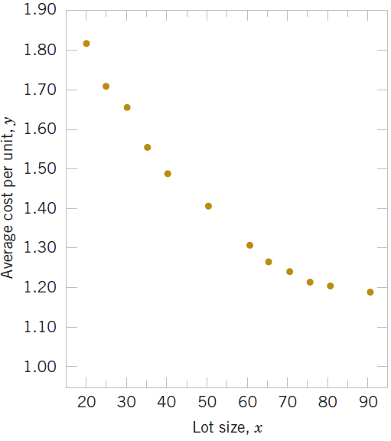
12-6: Aspects of Multiple Regression Modeling
Example 12-12
Figure 12-11 Data for Example 12-11.

Slide 70
Example 12-12
We will fit the model
Y = β₀ + β₁x + β₁₁x² + ε
The y vector, the model matrix X and the b vector are as follows:

Slide 71
12-6: Aspects of Multiple Regression Modeling
Example 12-12
Solving the normal equations gives the fitted model
Conclusions: The test for significance of regression is shown in
Table 12-13. Since f₀ = 1762.3 is significant at 1%, we conclude that at least one of the parameters β₁ and β₁₁ is not zero. Furthermore, the standard tests for model adequacy do not reveal any unusual behavior, and we would conclude that this is a reasonable model for the sidewall panel cost data.
TABLE • 12-9 Test for Significance of Regression for the Second-Order Model in Example 12-12
Source of
Variation Sum of Squares Degrees of Freedom Mean Square f₀ P-value
Regression 0.52516 2 0.26258 1762.28 2.12E-12
Error 0.00134 9 0.00015
Total 0.5265 11

Slide 72
12-6: Aspects of Multiple Regression Modeling
12-6.2 Categorical Regressors and Indicator Variables
Many problems may involve qualitative or categorical variables.
The usual method for the different levels of a qualitative variable is to use indicator variables.
For example, to introduce the effect of two different operators into a regression model, we could define an indicator variable as follows:

Slide 73
12-6: Aspects of Multiple Regression Modeling
EXAMPLE 12-13 Surface Finish A mechanical engineer is investigating the surface finish of metal parts produced on a lathe and its relationship to the speed (in revolutions per minute) of the lathe. The data are shown in Table 12-11. Note that the data have been collected using two different types of cutting tools. Since the type of cutting tool likely affects the surface finish, we will fit the model
Y = β₀ + β₁x₁ + β₂x₂ + ε
where Y is the surface finish, x₁ is the lathe speed in revolutions per minute, and x₂ is an indicator variable denoting the type of cutting tool used; that is,

Slide 74
12-6: Aspects of Multiple Regression Modeling
Example 12-13
TABLE • 12-11 Surface Finish Data for Example 12-13
Observation Number, i | Surface Finish y_{i} | RPM | Type of Cutting Tool | Observation Number, i | Surface Finish y_{i} | RPM | Type of Cutting Tool
1 | 45.44 | 225 | 302 | 11 | 33.50 | 224 | 416
2 | 42.03 | 200 | 302 | 12 | 31.23 | 212 | 416
3 | 50.10 | 250 | 302 | 13 | 37.52 | 248 | 416
4 | 48.75 | 245 | 302 | 14 | 37.13 | 260 | 416
5 | 47.92 | 235 | 302 | 15 | 34.70 | 243 | 416
6 | 47.79 | 237 | 302 | 16 | 33.92 | 238 | 416
7 | 52.26 | 265 | 302 | 17 | 32.13 | 224 | 416
8 | 50.52 | 259 | 302 | 18 | 35.47 | 251 | 416
9 | 45.58 | 221 | 302 | 19 | 33.49 | 232 | 416
10 | 44.78 | 218 | 302 | 20 | 32.29 | 216 | 416

Slide 75
12-6: Aspects of Multiple Regression Modeling
Example 12-13
The parameters in this model may be easily interpreted. If x₂ = 0, the model becomes
Y = β₀ + β₁x₁ + ε
which is a straight-line model with slope β₁ and intercept β₀. However, if x₂ = 1, the model becomes
Y = β₀ + β₁x₁ + β₂(1) + ε = (β₀ + β₂) + β₁x₁ + ε
which is a straight-line model with slope b₁ and intercept β₀ + β₂. Thus, the model Y = β₀ + β₁x + β₂x₂ + ε implies that surface finish is linearly related to lathe speed and that the slope β₁ docs not depend on the type of cutting tool used. However, the type of cutting tool does affect the intercept, and β₂ indicates the change in the intercept associated with a change in tool type from 302 to 416.

Slide 76
Example 12-13
The model matrix X and y vector for this problem are as follows:

Slide 77
12-6: Aspects of Multiple Regression Modeling
Example 12-13
The fitted model is
Conclusions: The analysis of variance for this model is shown in
Table 12-12. Note that the hypothesis H₀: β₁ = β₂ = 0 (significance of regression) would be rejected at any reasonable level of significance because the P-value is very small. This table also contains the sums of squares
SS_{R} = SS_{R}(β₁,β₂|β₀)
= SS_{R}(β₁|β₀) + SS_{R}(β₂|β₁,β₀)
so a test of the hypothesis H₀: β₂ = 0 made. Since this hypothesis is also rejected, we conclude that tool type has an effect on surface finish.

Slide 78
12-6: Aspects of Multiple Regression Modeling
Example 12-13
TABLE • 12-12 Analysis of Variance for Example 12-13
Source of Sum of Variation Squares |  | Degrees of Freedom | Mean Square | f₀ | P-value
Regression | 1012.0595 | 2 | 506.0297 | 1103.69 | 1.02E-18
SS_{R}(β₁|β₀) | 130.6091 | 1 | 130.6091 | 284.87 | 4.70E-12
SS_{R}(β₂|β₁,β₀) | 881.4504 | 1 | 881.4504 | 1922.52 | 6.24E-19
Error | 7.7943 | 17 | 0.4585
Total | 1019.8538 | 19

Slide 79
12-6: Aspects of Multiple Regression Modeling
12-6.3 Selection of Variables and Model Building
(12-33)

Slide 80
12-6: Aspects of Multiple Regression Modeling
12-6.3 Selection of Variables and Model Building
All Possible Regressions
EXAMPLE 12-14 Wine Quality Table 12-13 presents data on taste-testing 38 brands of pinot noir wine (the data were first reported in an article by Kwan, Kowalski, and Skogenboe in an article in the Journal of Agricultural and Food Chemistry, Vol. 27, 1979, and it also appears as one of the default data sets in Minitab). The response variable is y = quality, and we wish to find the “best” regression equation that relates quality to the other five parameters.
Figure 12-12 is the matrix of scatter plots for the wine quality data, as constructed by Minitab. We notice that there are some indications of possible linear relationships between quality and the regressors, but there is no obvious visual impression of which regressors would be appropriate. Table 12-14 lists the all possible regressions output from Minitab. In this analysis, we asked Minitab to present the best three equations for each subset size. Note that Minitab reports the values of , and
for each model.

Slide 81
12-6: Aspects of Multiple Regression Modeling
12-6.3 Selection of Variables and Model Building
All Possible Regressions – Example 12-14
From Table 12-14 we see that the three-variable equation with x₂ = aroma, x₄ = flavor, and x₅ = oakiness produces the minimum C_{p} equation, whereas the four-variable model, which adds x₁ = clarity to the previous three regressors, results in maximum (or minimum MS_{E}).
The three-variable model is
and the four-variable model is

Slide 82
12-6: Aspects of Multiple Regression Modeling
TABLE • 12-14 All Possible Regressions Computer Output for the Wine Quality Data
Best Subsets Regression: Quality versus |  |  | Clarity, Aroma, …
Response is quality
 |  |  |  |  |  |  |  |  | O
 |  |  |  |  | C |  |  |  | a
 |  |  |  |  | l |  |  | F | k
 |  |  |  |  | a | A |  | l | i
 |  |  |  |  | r | r | B | a | n
 |  |  |  |  | i | o | o | v | e
 |  |  |  |  | t | m | d | o | s
Vars | R-Sq | R-Sq (adj) | C–p | S | y | a | y | r | s
1 | 62.4 | 61.4 | 9.0 | 1.2712 |  |  |  | X
1 | 50.0 | 48.6 | 23.2 | 1.4658 |  | X
1 | 30.1 | 28.2 | 46.0 | 1.7335 |  |  | X
2 | 66.1 | 64.2 | 6.8 | 1.2242 |  |  |  | X | X
2 | 65.9 | 63.9 | 7.1 | 1.2288 |  | X |  | X
2 | 63.3 | 61.2 | 10.0 | 1.2733 | X |  |  | X
3 | 70.4 | 67.8 | 3.9 | 1.1613 |  | X |  | X | X
3 | 68.0 | 65.2 | 6.6 | 1.2068 | X |  |  | X | X
3 | 66.5 | 63.5 | 8.4 | 1.2357 |  |  | X | X | X
4 | 71.5 | 68.0 | 4.7 | 1.1568 | X | X |  | X | X
4 | 70.5 | 66.9 | 5.8 | 1.1769 |  | X | X | X | X
4 | 69.3 | 65.6 | 7.1 | 1.1996 | X |  | X | X | X
5 | 72.1 | 67.7 | 6.0 | 1.1625 | X | X | X | X | X

Slide 83
12-6.3: Selection of Variables and Model Building - Stepwise Regression
Example 12-15
TABLE • 12-15 Stepwise Regression Output for the Wine Quality Data
Stepwise Regression; Quality versus Clarity, Aroma, …
Alpha-to-Enter: 0.15 Alpha-to-Remove: 0.15
Response is Quality on 5 predictors, with N = 38
Step | 1 | 2 | 3
Constant | 4.941 | 6.912 | 6.467
Flavor | 1.57 | 1.64 | 1.20
T-Value | 7.73 | 8.25 | 4.36
P-Value | 0.000 | 0.000 | 0.000
Oakiness |  | -0.54 | -0.60
T-Value |  | -1.95 | -2.28
P-Value |  | 0.059 | 0.029
Aroma |  |  | 0.58
T-Value |  |  | 2.21
P-Value |  |  | 0.034
S | 1.27 | 1.22 | 1.16
R-Sq | 62.42 | 66.11 | 70.38
R-Sq(adj) | 61.37 | 64.17 | 67.76
C–p | 9.0 | 6.8 | 3.9

Slide 84
12-6.3: Selection of Variables and Model Building - Backward Regression
Example 12-15
TABLE • 12-16 Backward Elimination Output for the Wine Quality Data
Stepwise Regression: Quality versus Clarity, Aroma, …
Backward elimination. Alpha-to-Remove: 0.1
Response is Quality on 5 predictors, with N = 38
Step | 1 | 2 | 3
Constant | 3.997 | 4.986 | 6.467
Clarity | 2.3 | 1.8
T-Value | 1.35 | 1.12
P-Value | 0.187 | 0.269
Aroma | 0.48 | 0.53 | 0.58
T-Value | 1.77 | 2.00 | 2.21
P-Value | 0.086 | 0.054 | 0.034
Body | 0.27
T-Value | 0.82
P-Value | 0.418
Flavor | 1.17 | 1.26 | 1.20
T-Value | 3.84 | 4.52 | 4.36
P-Value | 0.001 | 0.000 | 0.000
Oakiness | -0.68 | -0.66 | -0.60
T-Value | -2.52 | -2.46 | -2.28
P-Value | 0.017 | 0.019 | 0.029
S | 1.16 | 1.16 | 1.16
R-Sq | 72.06 | 71.47 | 70.38
R-Sq(adj) | 67.69 | 68.01 | 67.76
C-p | 6.0 | 4.7 | 3.9

Slide 85
12-6: Aspects of Multiple Regression Modeling
12-6.4 Multicollinearity
Variance Inflation Factor (VIF)
(12-34)

Slide 86
12-6: Aspects of Multiple Regression Modeling
12-6.4 Multicollinearity
The presence of multicollinearity can be detected in several ways. Two of the more easily understood of these are:
1. The variance inflation factors, defined in equation 12-34, are very useful measures of multicollinearity. The larger the variance inflation factor, the more severe the multicollinearity. Some authors have suggested that if any variance inflation factor exceeds 10, multicollinearity is a problem. Other authors consider this value too liberal and suggest that the variance inflation factors should not exceed 4 or 5. Minitab will calculate the variance inflation factors. Table 12-4 presents the Minitab multiple regression output for the wire bond pull strength data. Since both VIF₁ and VIF₂ are small, there is no problem with multicollinearity.
2. If the F-test for significance of regression is significant, but tests on the individual regression coefficients are not significant, multicollinearity may be present.

Slide 87
Important Terms & Concepts of Chapter 12
All possible regressions
Analysis of variance test in multiple regression
Categorical variables
Confidence intervals on the mean response
Cp statistic
Extra sum of squares method
Hidden extrapolation
Indicator variables
Inference (test & intervals) on individual model parameters
Influential observations
Model parameters & their interpretation in multiple regression
Multicollinearity
Multiple regression
Outliers
Polynomial regression model
Prediction interval on a future observation
PRESS statistic
Residual analysis & model adequacy checking
Significance of regression
Stepwise regression & related methods
Variance Inflation Factor (VIF)

